Slide 1



Statistical methods of global air pollution modeling
University of Utrecht, The Netherlands
Meng Lu

Slide 2
S1 Air pollution mapping and data exploration Introduction Land use regression model Data Scripts data exploration: from visualization to preliminary examination S2 Machine learning methods Introduction machine learning methods Scripts How to use them, modeling parameter tuning, partial dependence plot, variable importance S3 Prediction (map) and result analysis Scripts Predicting using Lasso, random forest, xgboost Results

Slide 3


Slide 4
Land use regression and data used in the project
Part 1

Slide 5
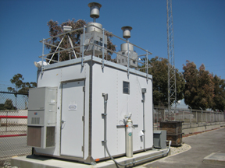

Predicting air pollution and analyzing the sources.
Land use regression (LUR)
$$y=β0+β1x1+β2x2+⋯+βnxn$$
Sensor measurements:
Station measurements
Mobil sensors
Remote sensing measurements:
OMI (250 km)
Tropomi (8 km)
…
GIS predictors:
Population
Road length within a buffer
Distance to roads
Traffic load
…

Slide 6
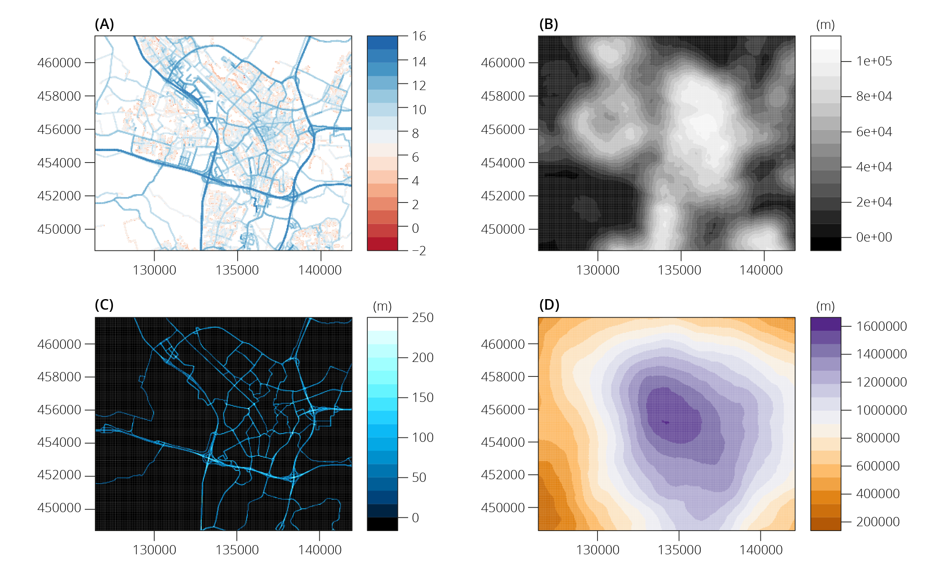
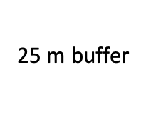
Buffered predictors
25 m buffer
1000 m buffer
Notes:
x

Slide 7
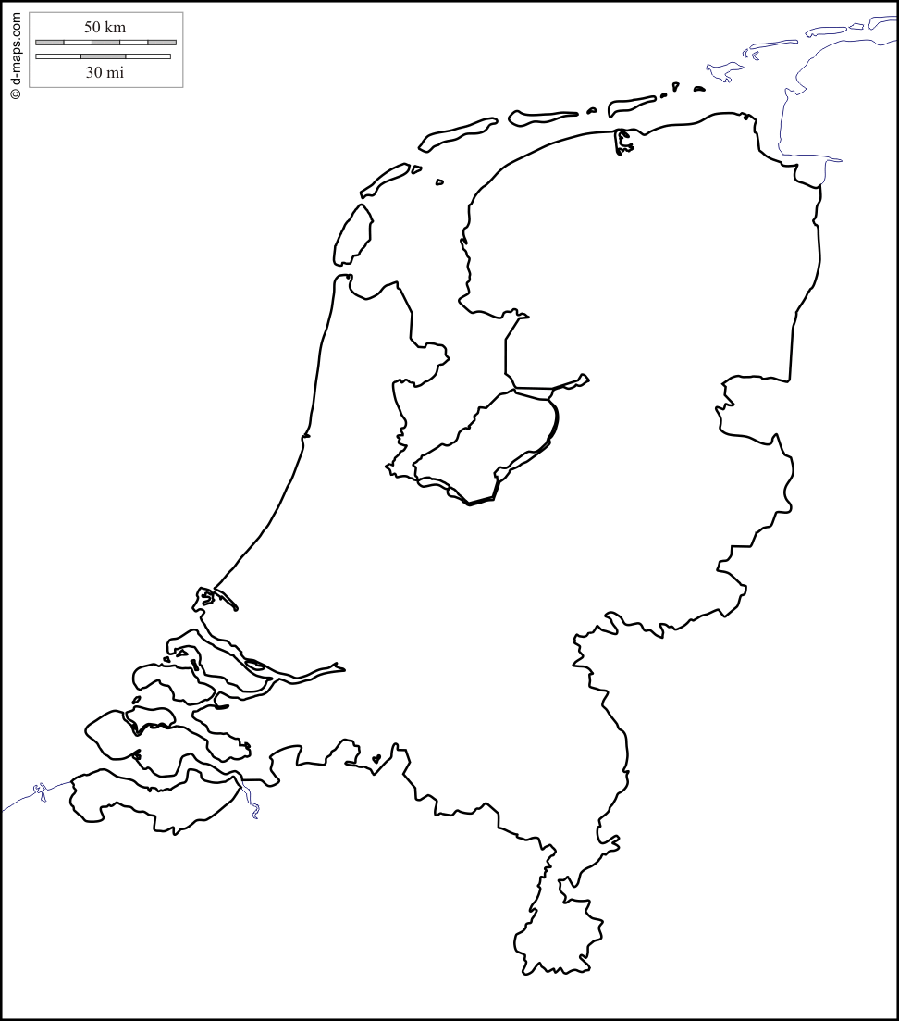
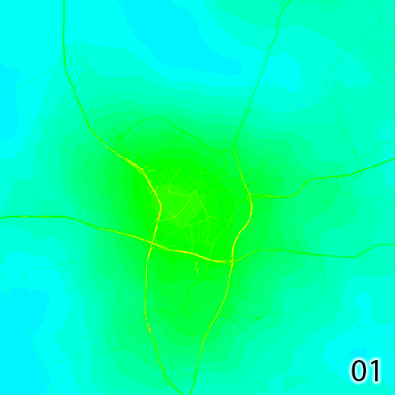


LUR prediction of NO₂
Spatiotemporal dynamic of air pollution showing road effects
60
30
0
0
5km
Hour
5 m resolution

Slide 8

Ground monitor Data: OpenAQ
(2017)

Slide 9
Predictors
Road types: Highway, primary roads, local roads
Emission-related
Road length and industry area within 25 m – 300 m radius ring
Background
Road length within 300 m - 5000 m radius ring
Population: 1 km, 3 km, 5 km
Industry area 300m - 5km
Monthly wind speed (0.5 degree)
Monthly temperature (0.5 degree)
Surface concentration product from Satellite products and the GEOS-CHEM
Satellite measured NO2 column density

Slide 10
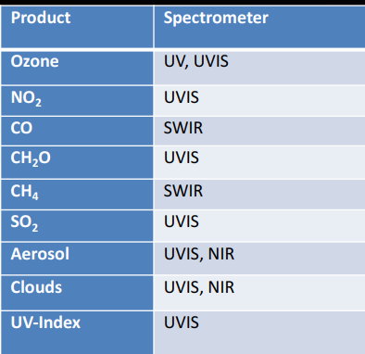
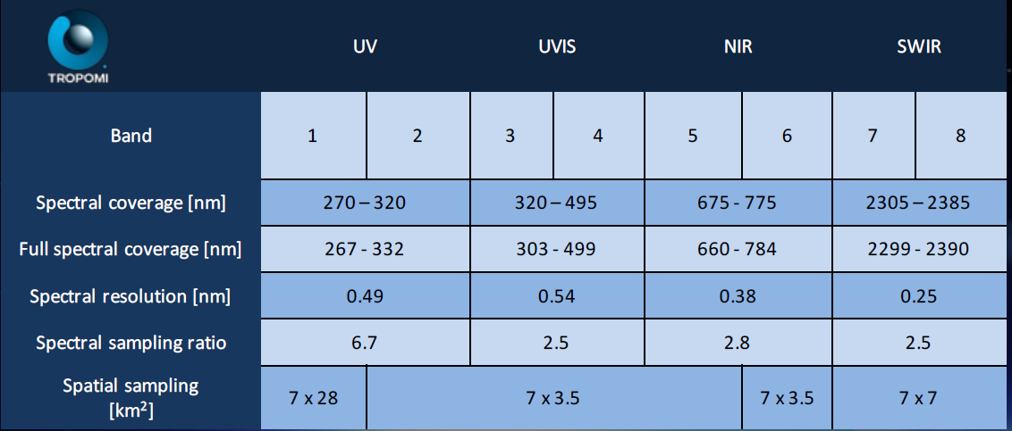
Tropomi
Feb 2018 to Jan 2019

Slide 11
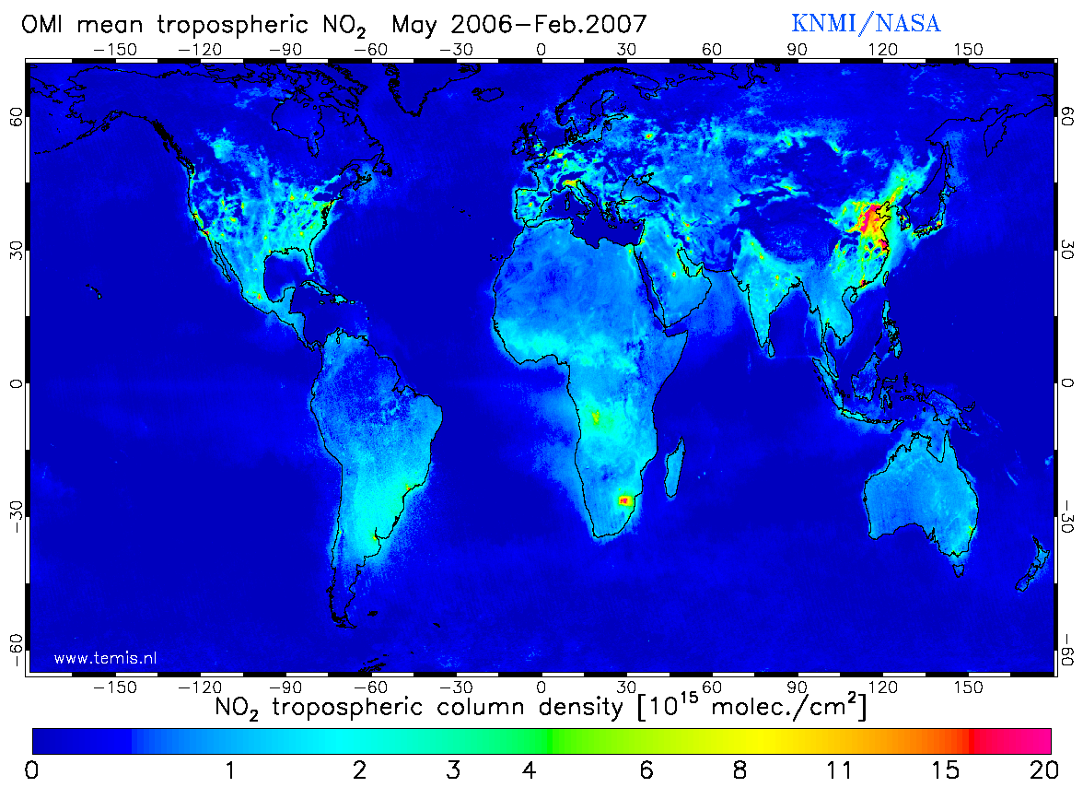
Remote sensing measurements: OMI (Ozone Monitoring Instrument)
Date of Launch | 15 July 2004
At nadir 13 km × 24 km
NO2, SO2, BrO, OCIO, O3 (36 km × 48 km)
Spectral bands: ultraviolet and visible (270 to 500 nm)
Zoom in mode 13 km× 12 km
Daily global coverage

Slide 12
surface product based on remote sensing and GEOS-CHEM
Chemical transportation models: GEOS-CHEM
global prediction are of coarse resolution - > integrating RS data
Surface NO2 product made using GEOS-CHEM together with GOME, SCIAMACHY, and GOME-2 satellite instruments. http://fizz.phys.dal.ca/~atmos/martin/?page_id=232
The surface product is used in our model.

Slide 13
Road length | https://www.openstreetmap.org/
Industrial area | https://www.openstreetmap.org/
Population | http://www.integrated-assessment.eu/eu/index.html
Elevation | https://www2.jpl.nasa.gov/srtm/
Wind speed | https://confluence.ecmwf.int/pages/viewpage.action?pageId=74764925
Temperature | https://confluence.ecmwf.int/pages/viewpage.action?pageId=74764925
TROPOMI | http://www.tropomi.nl
NO2 Surface product | http://fizz.phys.dal.ca/~atmos/martin/?page_id=232
OMI | https://mirador.gsfc.nasa.gov/cgi-bin/mirador/presentNavigation.pl?tree=project&dataset=OMNO2d.003&project=OMI&dataGroup=L3_V003&version=003&CGISESSID=57642d429543194f1007d9b91bfab0ae

Slide 14
Statistical learning 1980, computer science, machine learning, neural networks, zipcode recognision problem, bell lab
Part 2 (1)

Slide 15




Statisitcal learning

Slide 16
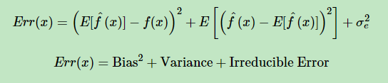

Bias-variance trade-off
All algorithms are affected by bias-variance trade-off

Slide 17
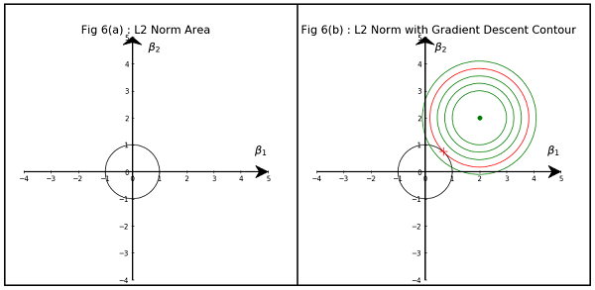
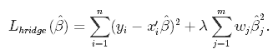
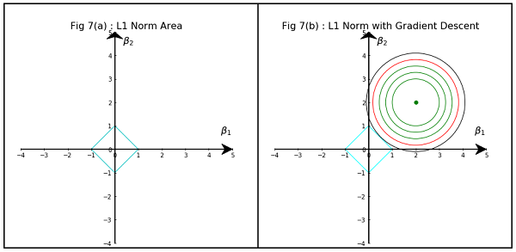
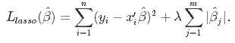
Regularization
Ridge regression
Lasso regression

Slide 18
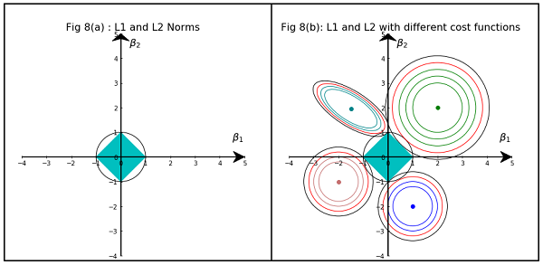
Lasso vs. Ridge
ElasticNet

Slide 19
Regression trees
Leveraging trees to improve the performance:
Bagging
Boosting
Random forest
Features:
Non-parametric
Different kinds of variables
Redundant variables are ignored
Handle missing data
Small trees are easy to interpret
Dominance
Boosting > Randomforest > bagging > single tree
Is it true that boosting trees are always better than the randomforest?

Slide 20
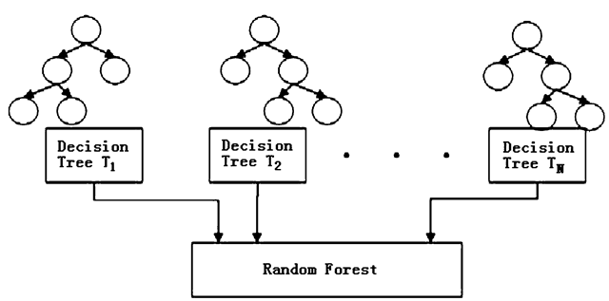
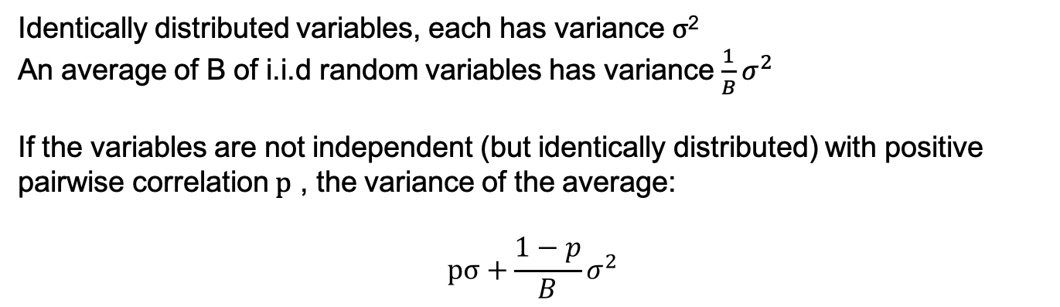
Random forest
variance reduction
Identically distributed variables, each has variance $σ$²
An average of B of i.i.d random variables has variance $\frac{1}{B}σ^{2}$
If the variables are not independent (but identically distributed) with positive pairwise correlation $p$ , the variance of the average:
$$pσ+\frac{1−p}{B}σ^{2}$$
“the more uncorrelated, the more you bringing down the variance”.
(tunning parameter: number of trees, tree depth)

Slide 21
More details
For each tree:
Bootstraping sample D* from the training data D
Draw m* variables randomly from all variables m, pick the best split-point (variable), split the node.
Limitation:
Bias towarding variables with many splits or missing variables, does not assess uncertainty
Variations:
Recursive partition trees:
Hypothesis testing of dependency between variables and resursively fitting the splitting weight
Baysian based sampling and variable selection:
Baysian framework for 1 and 2
Quantile random forest:
Estimate quantiles (beyond the conditional mean)

Slide 22
Stochastic gradient Boosting (regression)
-- Reweight based on the previous trees, stage-wise fitting
Each successive tree is built for the prediction residuals of the preceding tree in an adaptive way to reduce bias.
.
initial:
r = y
fit a regression tree to r: g(x)
for each tree:
f(x) = e*g(x)
r = r – f(x)
(Stochastic) Gradient Boosting
approach the gradient of the loss function (e.g. binomial, logistic, poison) by trees.
Each consecutive tree is built for the prediction residuals (from all preceding trees) of an independently drawn random sample
(r: residual; e: learning rate)

Slide 23

Learning Rate
Stochastic Gradient Boosting
Each consecutive tree is built for the prediction residuals (from all preceding trees) of an independently drawn random sample

Slide 24
XGboost
Exteme gradient boosting
Idea
Not only impurity, but also model complexity
obj(θ) = L(θ) + Ω(θ)
Features
Parallel computation
Support dense and sparse matrix
Can costomize objective fucntions

Slide 25
Hyperparameters
nrounds:
Controls the maximum number of iterations.
Tuned by CV
Eta:
Controls the learning rate,
It must be supported by increase in nrounds.
max_depth:
It controls the depth of the tree. Larger data sets require deep trees to learn the rules from data.
Tuned by CV
Gamma:
Controls regularization (or prevents overfitting).
Higher the value, higher the regularization. Regularization means penalizing large coefficients which don't improve the model's performance.
If you see train error >> test error, bring gamma into action.
Norms:
L1 norm (alpha) and L2 norm (lambda)

Slide 26
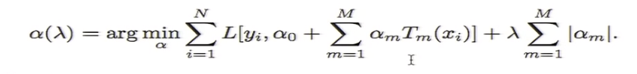
Postprocessing
Lasso regularization of regression trees
--- discarding trees that are not useful

Slide 27
What can the machine learning methods tell? Partial dependence plot, trees, variable importance
Part 2 (2)

Slide 28
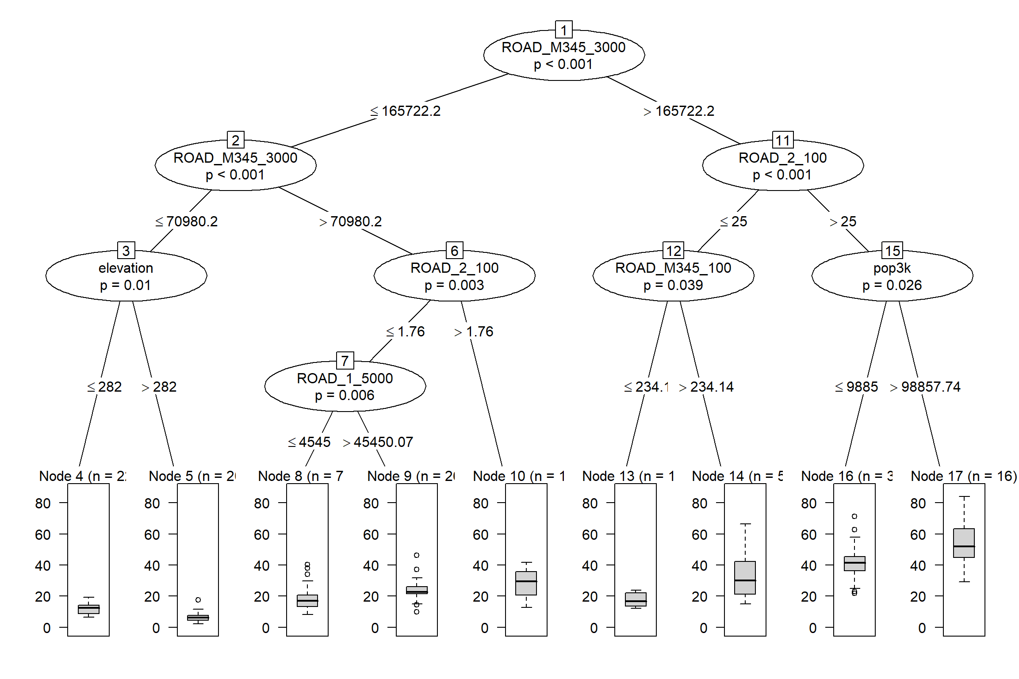
A closer look at the model
ROAD_M345: secondry
and local roads
Pop_: population
ROAD_2: primary roads
ROAD_1: highway
Visualizing a tree

Slide 29
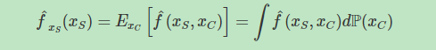
Partial dependence.
-- Shows the relationship between the target and a feature.
Xs : the features of the partial dependence function
Xc: the other features used in the machine learning model
Marginalizing the model output over the distribution of the features in set C,
Assumption: the features in C are not correlated with the features in S

Slide 30
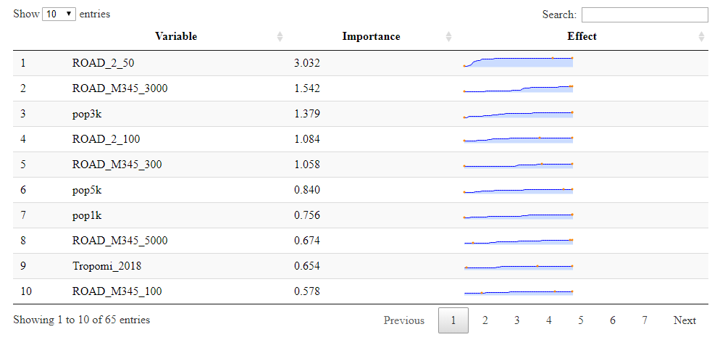

Slide 31
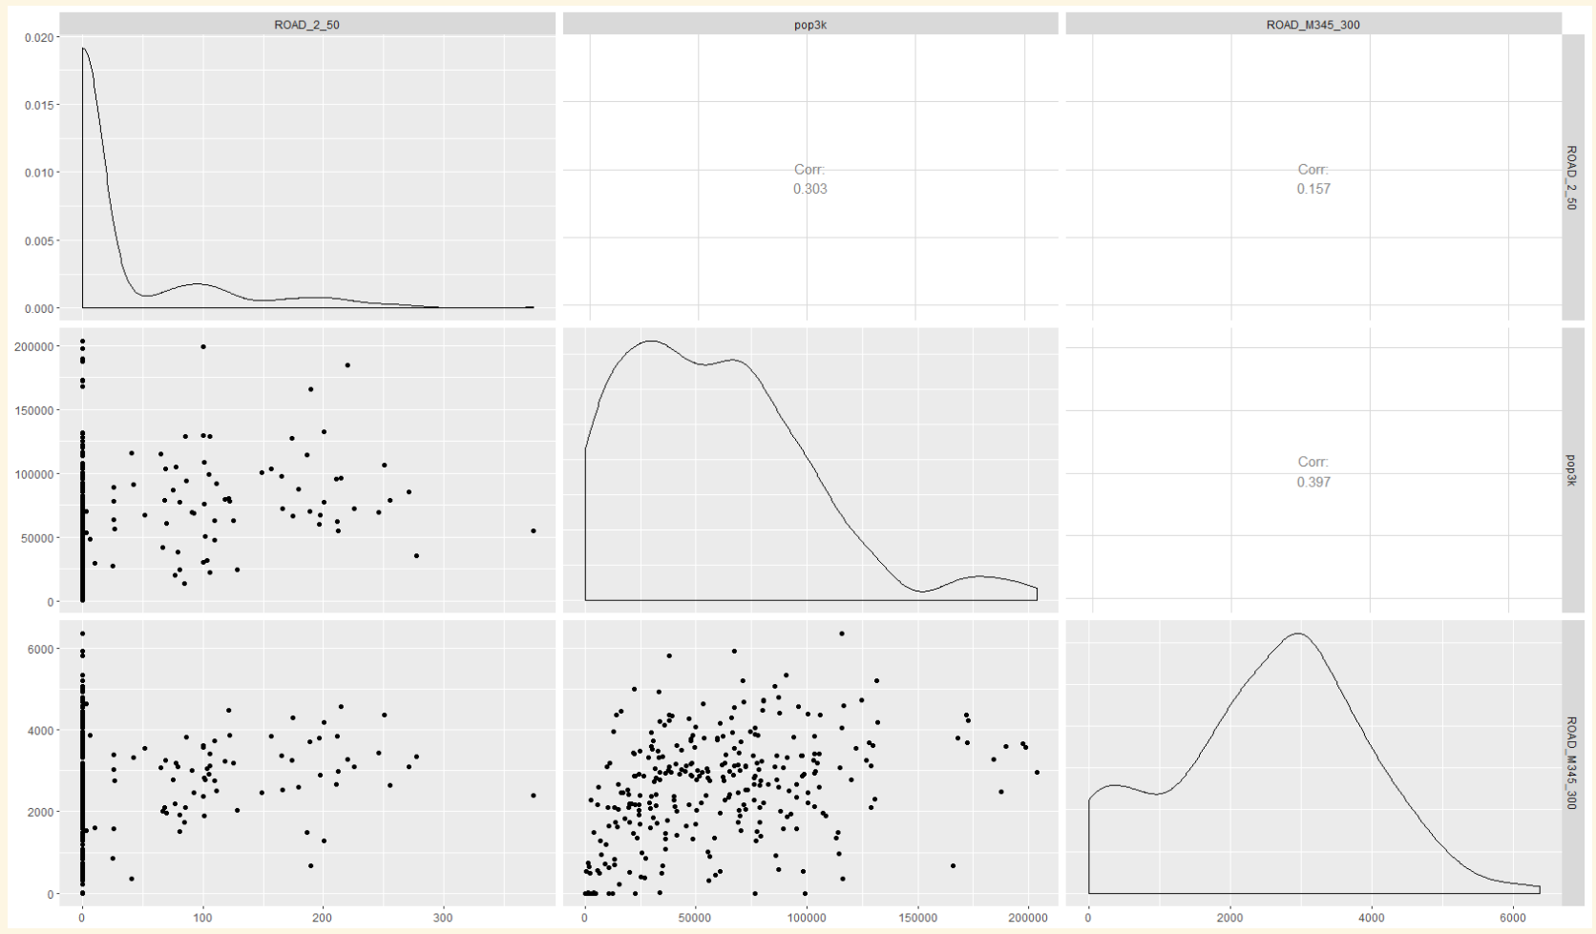
ROAD 2, 50m
Population, 3km
ROAD M345, 300m
Correlation:
0.3
Correlation:
0.16
ROAD M345, 300m
Correlation:
0.4
Population, 3km
ROAD 2, 50m
30m
120000m
5000m

Slide 32
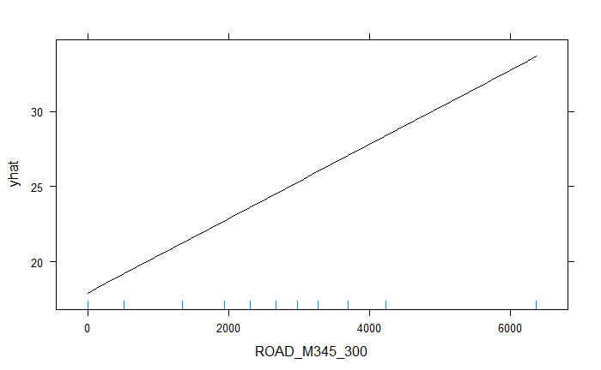
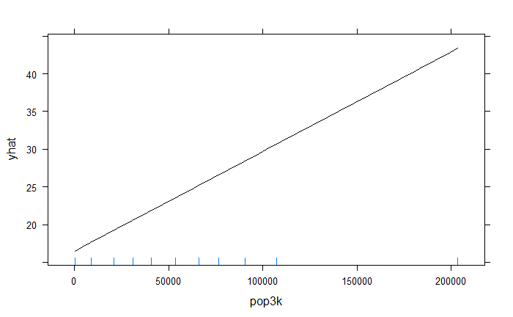
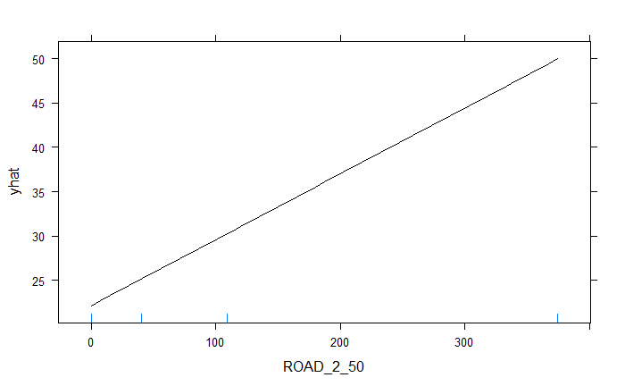
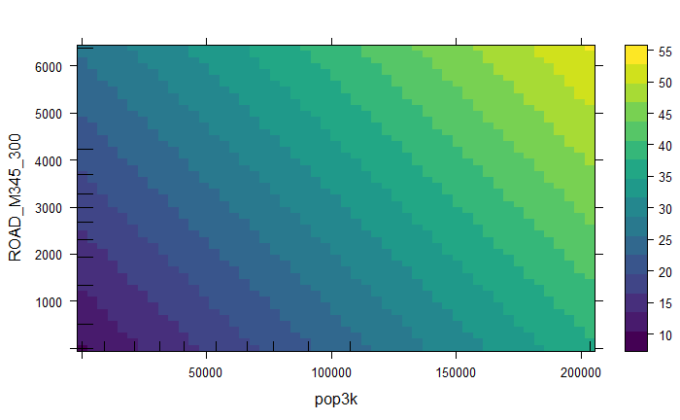
Partial dependent plots: Linear regression
ROAD M345, 300m
Population, 3km
ROAD M345, 300m
ROAD 2, 50m
Population, 3km

Slide 33
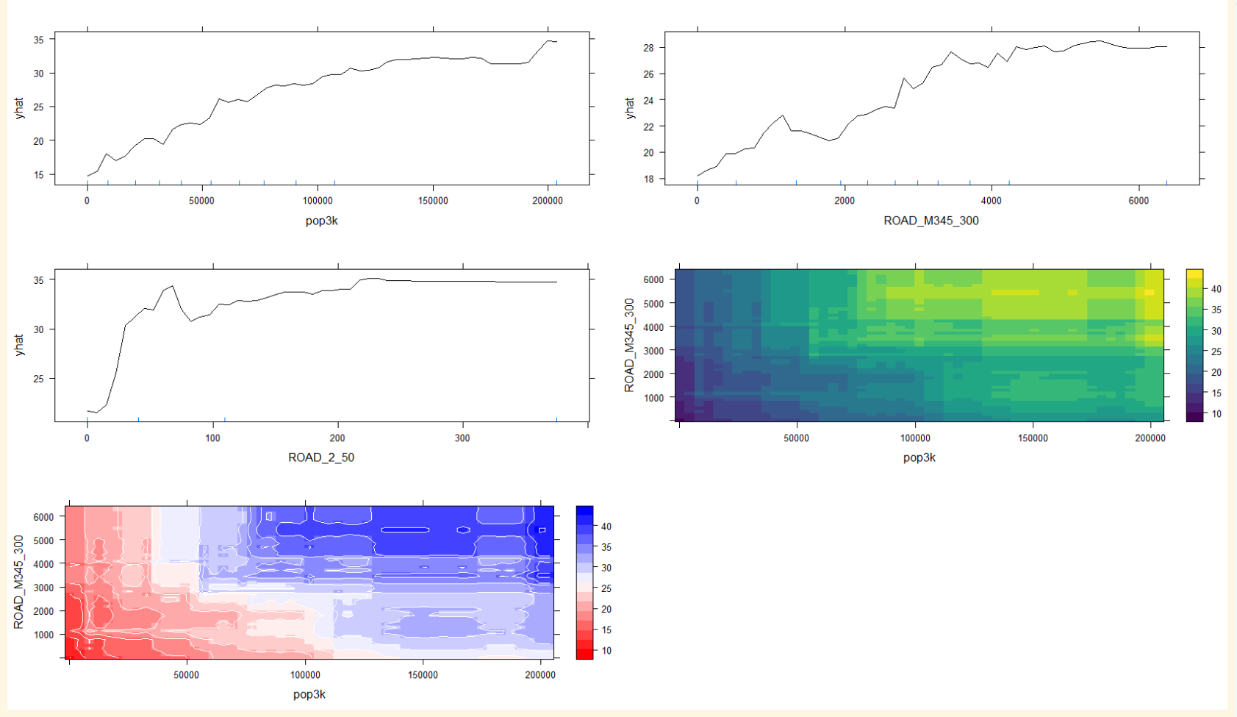
Partial dependent plots: Random forest
Population, 3km
120000m
ROAD M345, 300m
5000m
30m
ROAD M345, 300m
ROAD 2, 50m
Population, 3km
40
ROAD M345, 300m
4000
Population, 3km

Slide 34
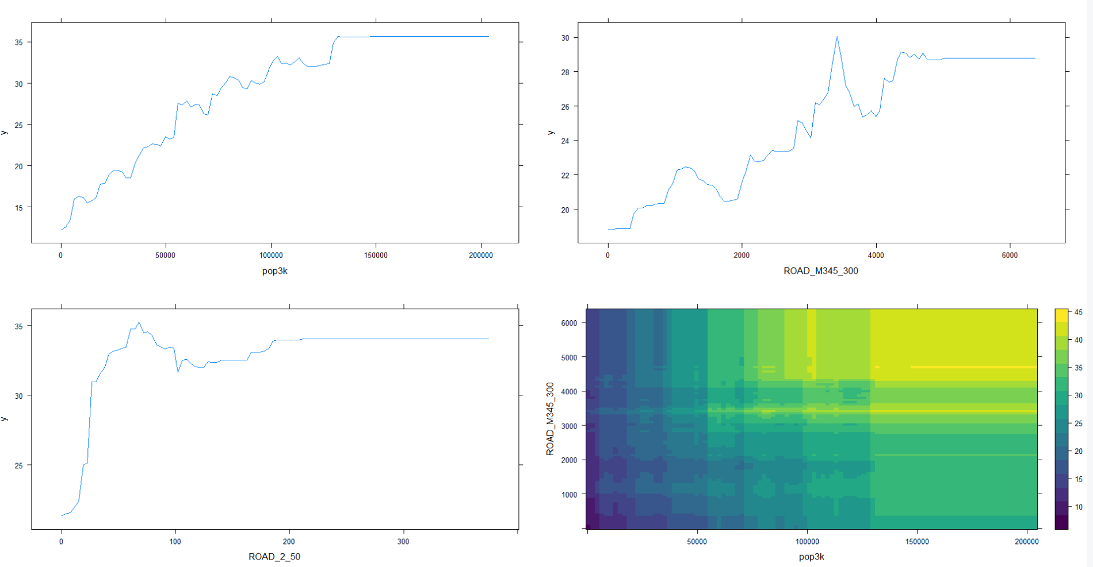
Partial dependent plots: stochastic gradient boosting
Population, 3km
120000m
ROAD M345, 300m
5000m
30m
ROAD M345, 300m
ROAD 2, 50m
Population, 3km

Slide 35
predicting and results
Part 3

Slide 36
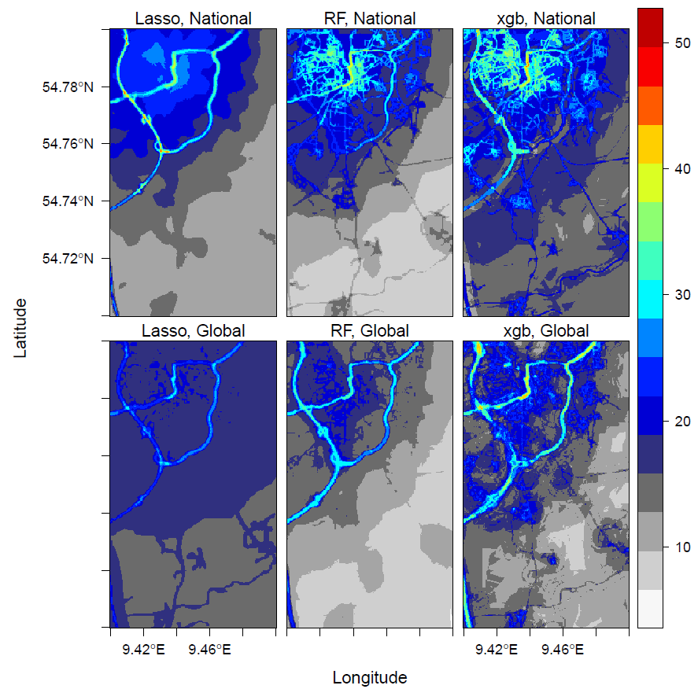
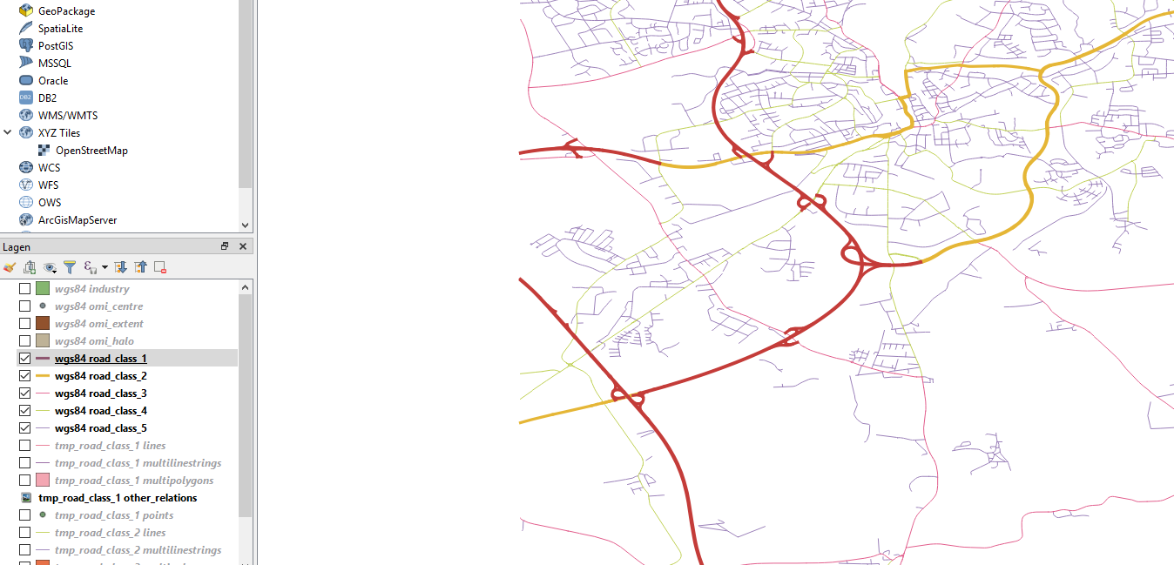
Germany
highway
primary

Slide 37
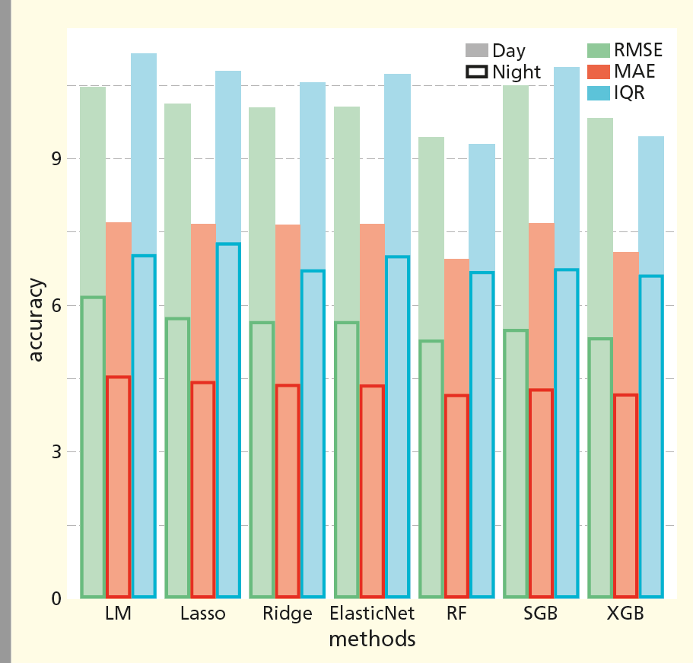
Germany
RMSE: root mean squared error
MAE: mean absolute error
IQR: interquartile range
LM: Multiple linear regression
RF: random forest
SGB: Stochastic gradient boosting
XGB: xgboost

Slide 38
Important emition-related variables
National model of Germany
Ranked top 20 by Random Forest Primary road 25m, 50 m, 100 m Local road 25m, 50 m, 100 m, 300 m Ranked top 20 by XGBoost Primary road 50 m, 100 m Highway 50 m Local road 25m, 50 m, 100 m, 300 m Selected by LASSO Primary road 25m, 50 m, 100 m Highway 50m, 100 m Local road 100 m, 300m
Global model
Ranked top 20 by Random Forest* Primary road 50 m, 100 m Ranked top 20 by XGBoost Primary road 50 m, 100 m Highway 100 m Local road 25 m, 50 m, 100 m Selected by LASSO Primary road 50 m, 100 m Highway 50 m, 100 m Local road 25 m, 50 m, 100 m
*Highway 100 m ranked 26

Slide 39
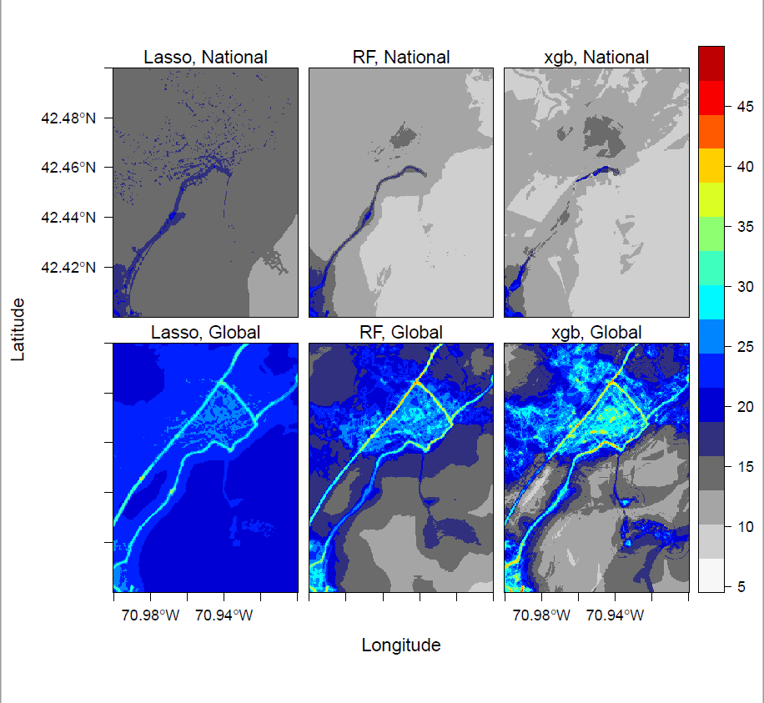
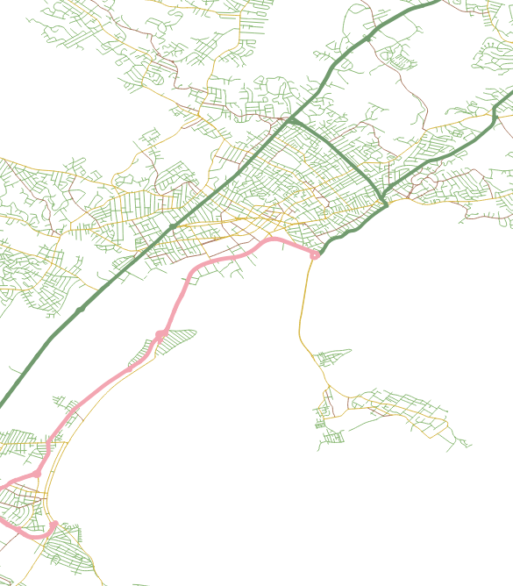
US
primary
highway

Slide 40
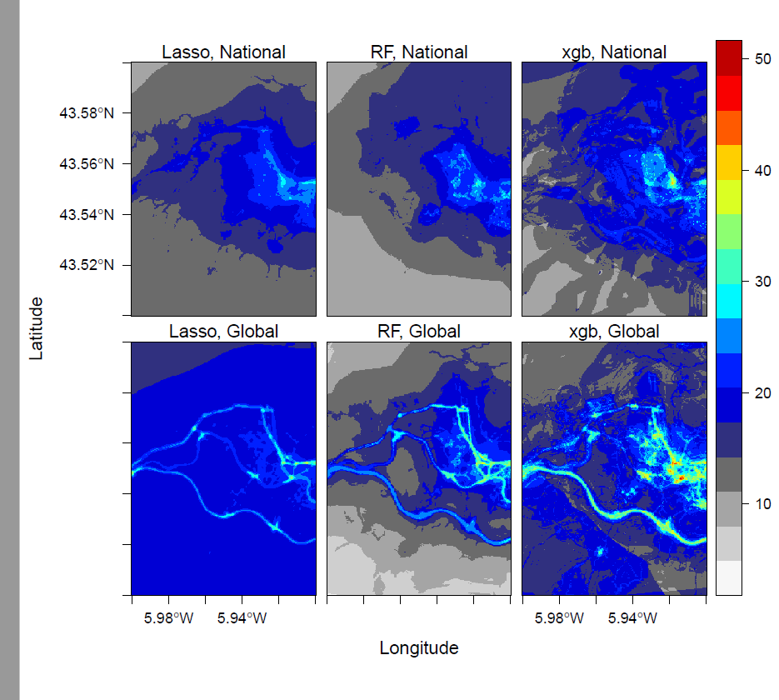
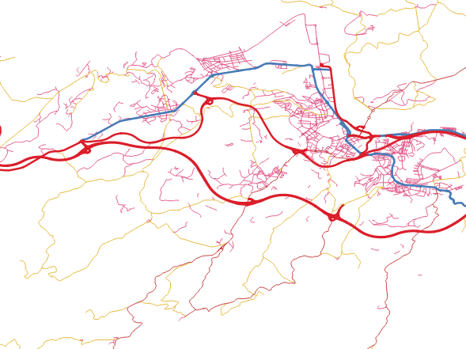
Spain
primary
highway

Slide 41
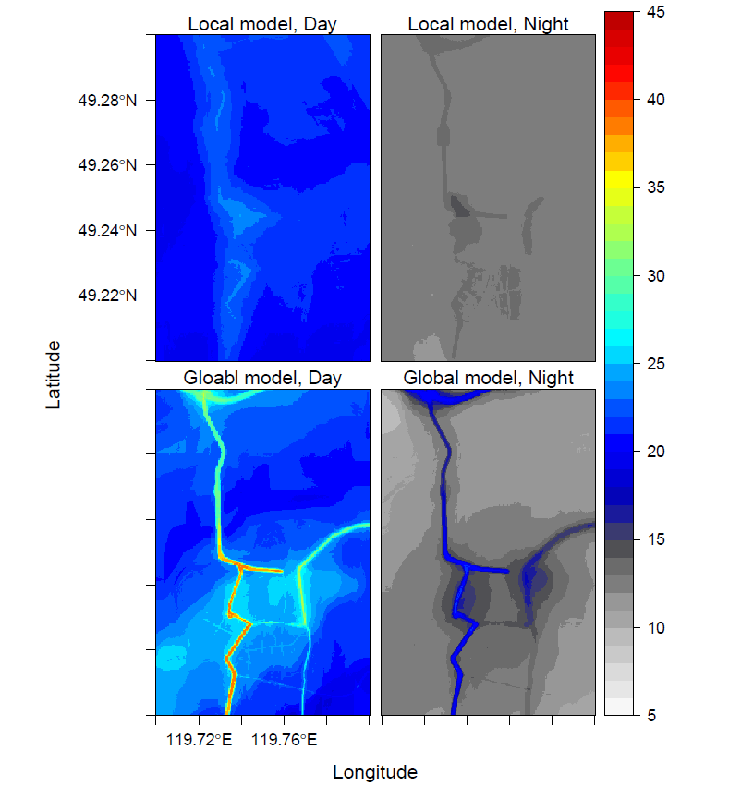
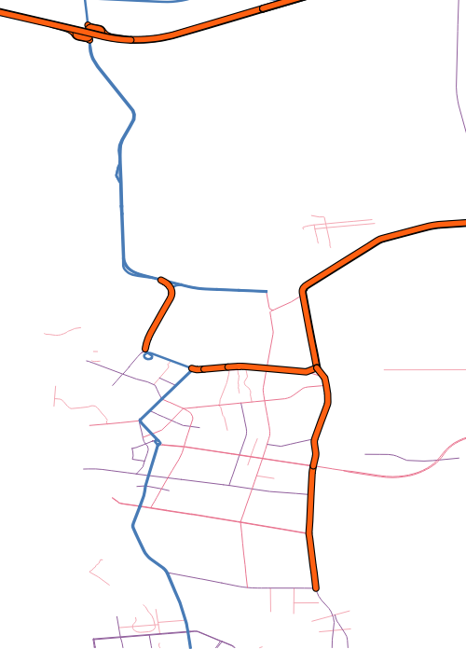
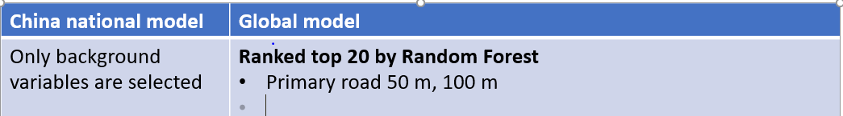
Random Forest
Prediction: China
primary
highway

Slide 42
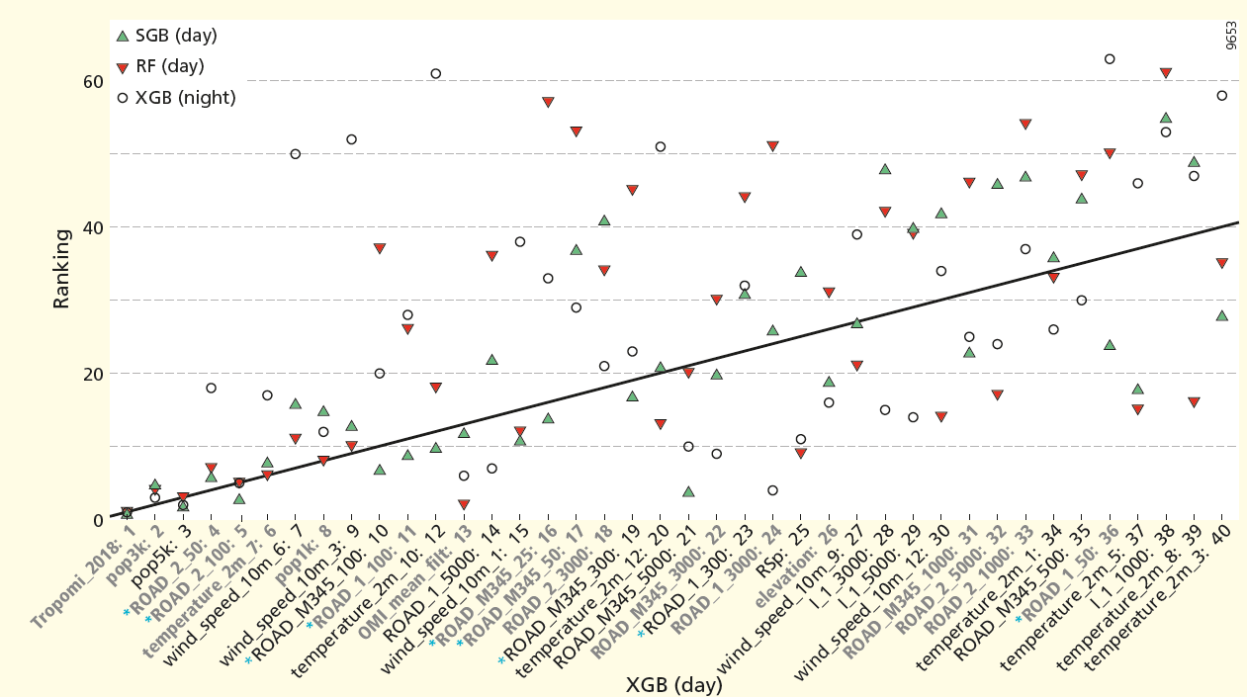
Variable importance
ROAD_M345: secondry and local roads
Pop_: population ROAD_2: primary roads
Global model

Slide 43
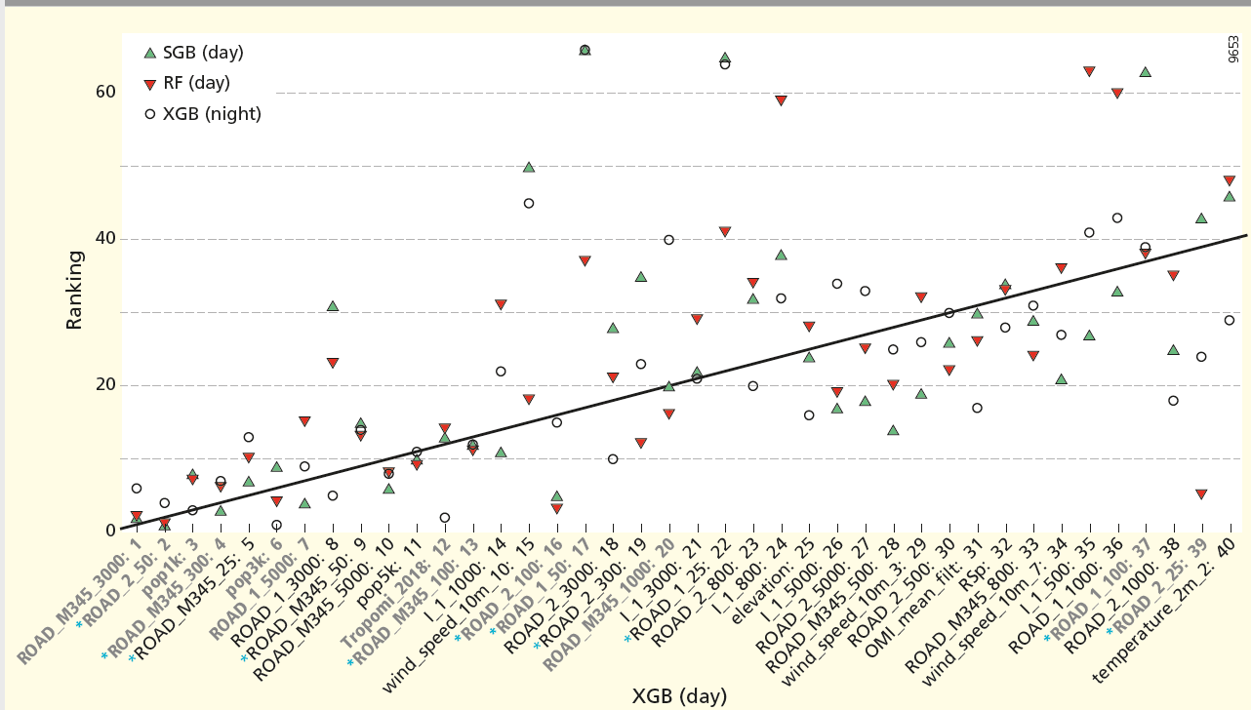
Variable importance
ROAD_M345: secondry and local roads
Pop_: population ROAD_2: primary roads
Germany

Slide 44
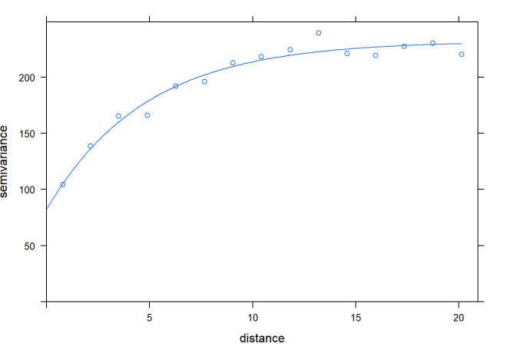
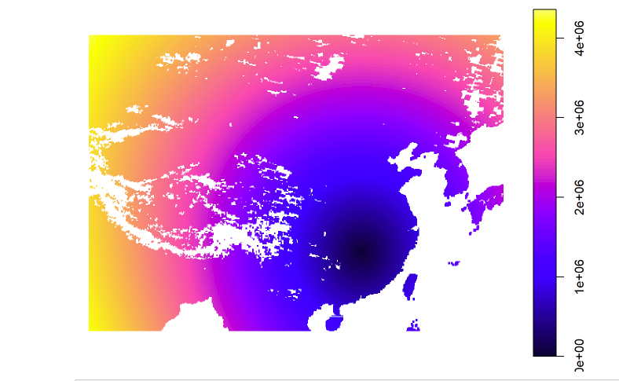
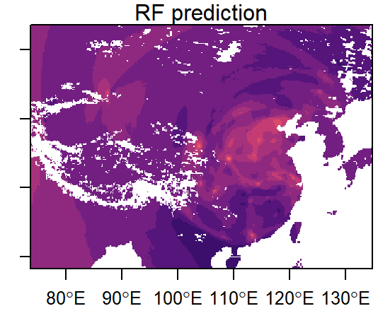
Using random forest for Geostatistic-like interpolation
http://rpubs.com/menglu/473973

